Slide 1
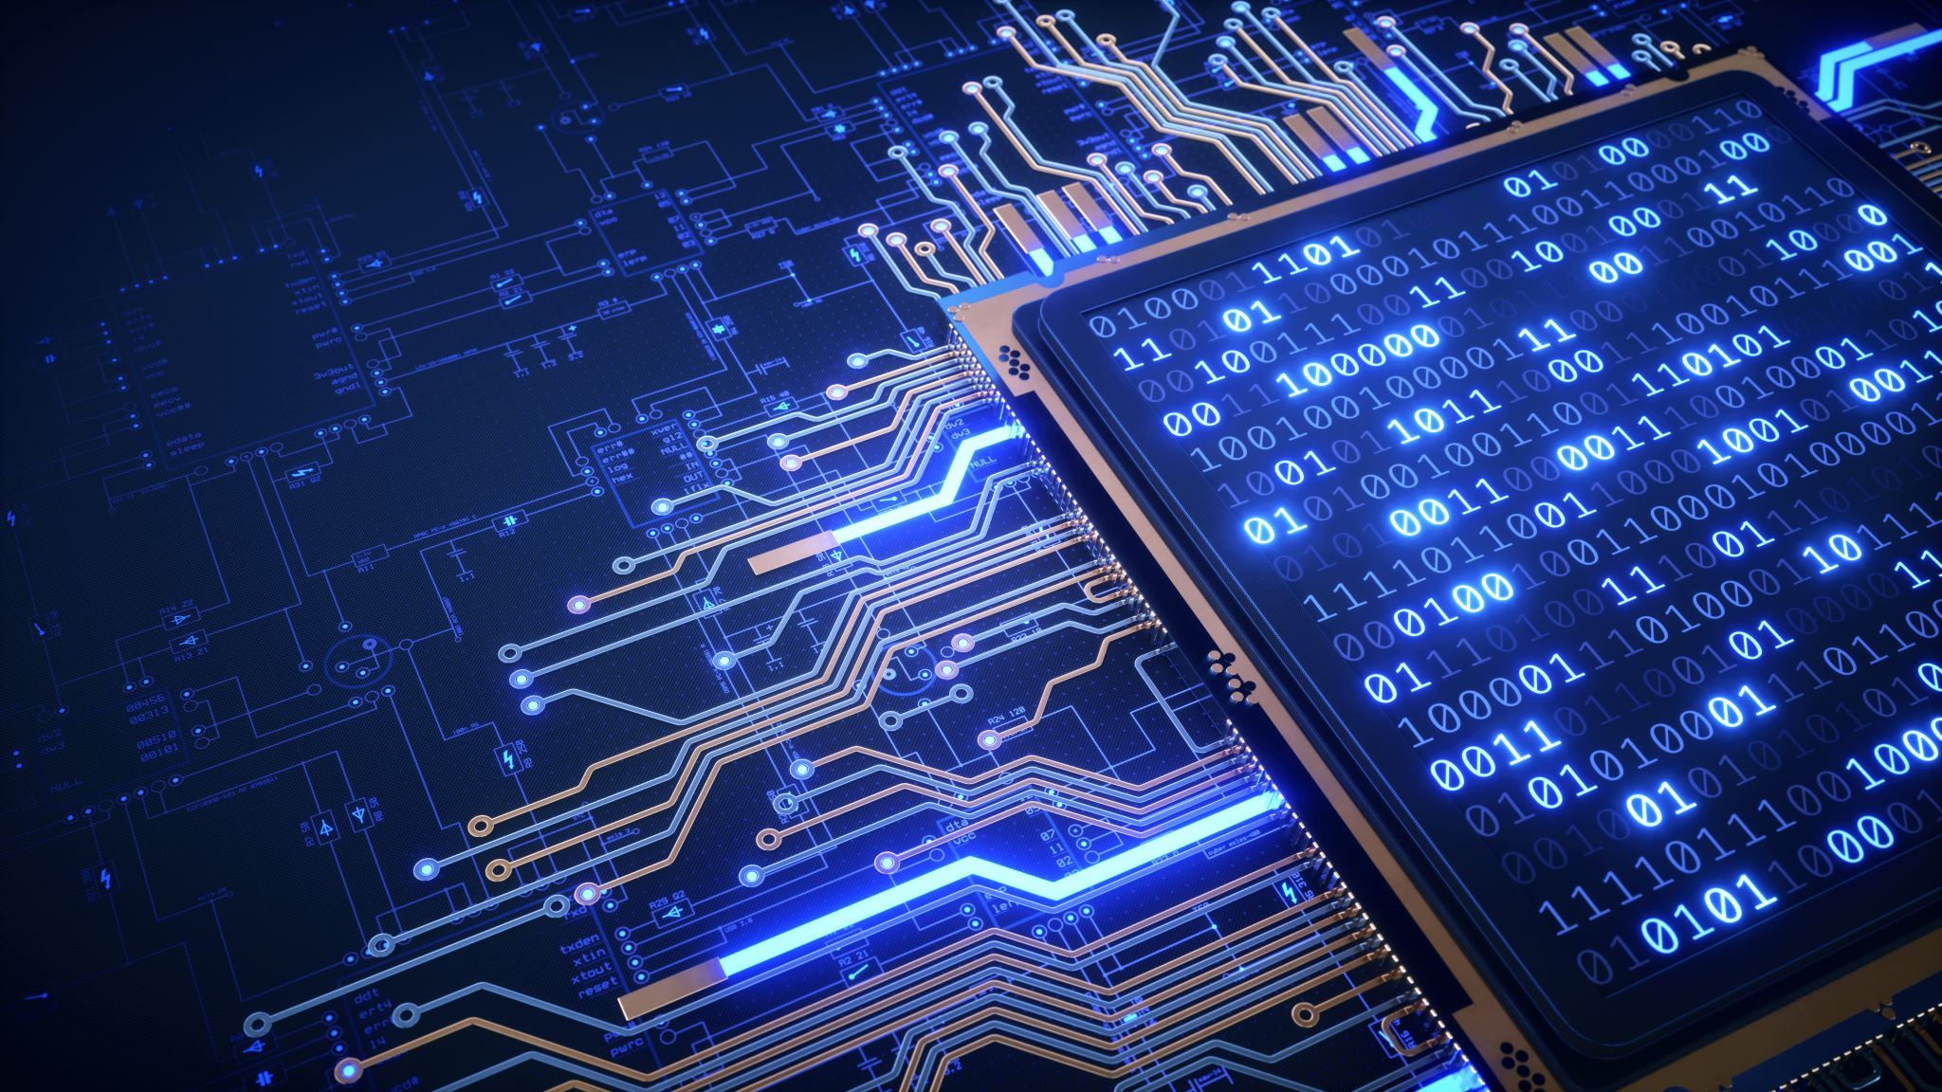
Freenet as a broker for „Medical“ IoT Data
Bachelor thesis– Bern University of Applied Science
18.06.2021
Student: Yannick Stebler
Professor: Prof. Dr. Emmanuel Benoist
Expert: Daniel Voisard
Notes:
I would like to welcome you to my Bachelor Thesis presentation about Freenet as a broker for "Medical" IoT Data.

Slide 2
Index
Topic – Problem definition
Goals
Freenet (Broker)
Architecture
Attacks
Conclusion
Questions
Notes:
Let's get to the content of my presentation.
First of all, I will present you the topic and the exact problem.
Then I will present the goals of my work.
After that I will introduce you to Freenet, a predefined component of my work.
Next, we will move on to the architecture that contains the new communication path.
Furthermore, I will present some attacks that I had to deal with during the development of the architecture.
Finally we come to a conclusion and an outlook on future extensions.

Slide 3
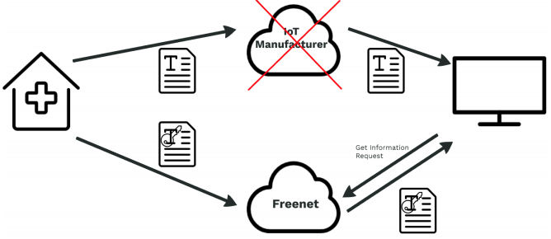
Topic - Problem definition
IoT devices are on the rise
Many make everyday tasks easier
Same problem for all of them
Data Exchange via manufacturer
Dependency to the manufacturer
In case of bankruptcy device useless
=
Notes:
IoT devices are on the rise and it's hard to imagine our everyday lives without them.
They facilitate many everyday tasks, collect information or connect us with other people.
Every day, new applications for these small and often practical devices are added.
However, most if not all of these IoT Devices have the same problem.
The data exchange of IoT devices is often handled by the manufacturer of the devices.
Which leads to a strong dependency on the manufacturer.
This dependency has the advantage that you do not have to worry about the hardware over which the IoT devices share data.
However, it also leads to the fact that you have no control over the data exchange and possible storage.
Another very big disadvantage is that if the manufacturer goes bankrupt, the IoT devices can become useless.

Slide 4
Goals
Define new communication path
Largely anonymous communication
Protect the exchange of data
Data access only for authorized parties
Document the architecture of the new communcation path
Implement it in a small prototype
IoT sending device programmed with C
Receiver programmed with C#
Notes:
Therefore, my goal with this bachelor thesis was to develop a new communication path for IoT devices and thus achieve a certain independence from the manufacturer.
This communication path should have some very essential properties.
The communication must be largely anonymous. It should not be possible to identify who sent which data and who read it based on the data flow.
Furthermore, all data transmitted should be protected against access by unauthorized third parties.
The architecture created for this should be documented in this thesis and implemented in a small prototype.
This prototype consisted of two parts, the IoT transmitter, which was programmed with C. And the receiver a small C# program

Slide 5

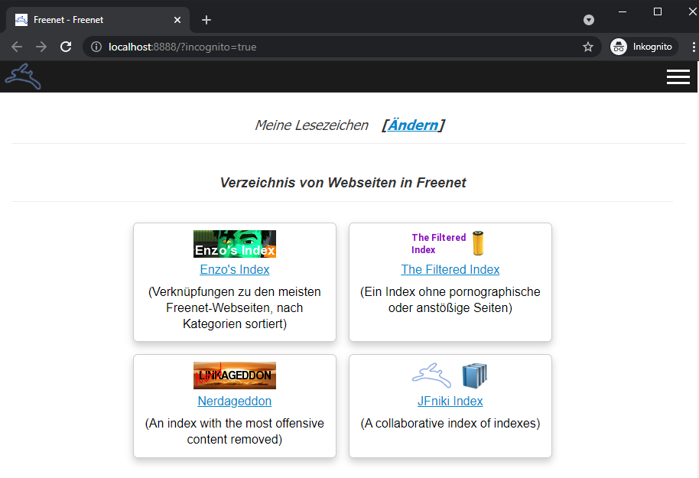
Freenet (Broker)
Free software
Peer-to-peer platform for censorship-resistant communication
Share files, browse and publish „freesites“ and chat on forums
Encrypted communication
Contribute to the network with bandwith and a portion of hard drive storage
Is used as Broker in my Thesis
More information on: https://freenetproject.org
Notes:
Let's also move on to Freenet the broker of my new communication path.
A broker is a server or service that caches data from clients and makes it available for retrieval. It thus represents the communication interface between two end devices.
Freenet is a peer-to-peer platform for censorship resistant communication. It uses a decentralized distributed data store to store and exchange data.
All communication within the Freenet peer-to-peer network is encrypted.
Users who use Freenet contribute to the network by providing a portion of their bandwidth and a portion of their hard drive (called the “data store”) for storing files.
These stored files on the hard drive are automatically kept or deleted depending on how popular they are, they are also encrypted, so generally the user cannot easily discover what is in his datastore, and hopefully can’t be held accountable for it. Chat forums, Freesite (a Website inside Freenet) and search functionality are all built on top of the distributed data store.

Slide 6
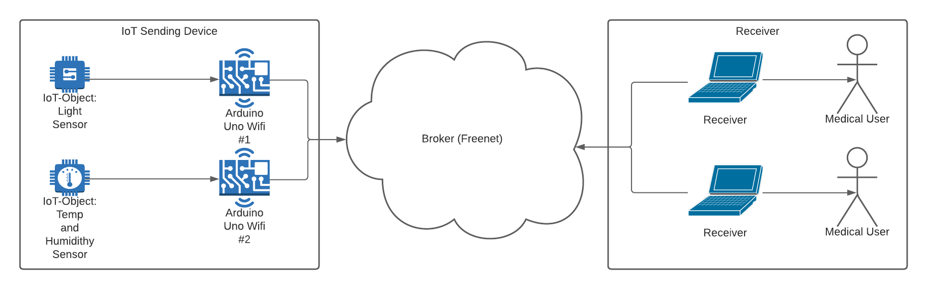
Architecture – Overview
Notes:
In the following figure you can see an overview of the architecture of the new communication path.
On the left we have the 2 Arduino Uno Wifi devices with the different sensors.
These serve as our IoT transmitters.
The cloud in the middle represents our broker Freenet, which is the interface for the data exchange.
And on the right you can see the receivers. Which are to represent the data received to the medical staff.

Slide 7
Architecture – Initialisation 1
Freenet uses his own Protocol FCP – Freenet Client Protocol
Input limitation of small IoT device
Scratchable QR-code of upload URI (Path)
URI (USK – Updateable Subspace Key) Example – Generated by Freenet
USK@VuHdPK~~8ArRcYhGU7JlibgTKSrnxLRH4jR1PCiHrUU,9SFpiAvN3pBYHyY~OSkwIk7wU33WYIU3a7Rt1fdmz~8,AQECAAE/temp/1
Notes:
Now I will explain the two processes for the initialization and the exchange of data via the new communication path.
Freenet uses its own protocol for communication, the so-called FCP - Freenet Client Protocol.
It is a simple, text-based protocol that allows third party applications to interact with freenet.
In order to be able to exchange data via freenet, the data is stored with a key.
For this purpose a new keypair is requested from freenet for upload and download of the data.
Since the small IoT devices often have no possibility to accept or display an input or an output directly,
we decided to provide each IoT transmitter with a scratchable QR code with the Freenet upload address.
If this QR code is already scratched on delivery, it can be determined that this has already been read and is therefore no longer safe for the first use.

Slide 8
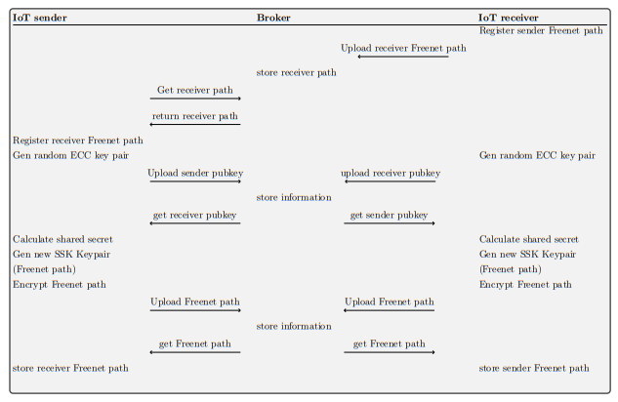
Architecture – initialization 2
Steps:
Scan QR-Code Sender on Receiver
Register Receiver URI on Sender
Both generate ECDH Keypair
Exchange Public Keys
Calculate Shared Secret and Generate new URIs
Exchange Encrypted URIs
Notes:
On the right is an illustration of the communication setup between an IoT transmitter and the receiver.
The following steps are taken to establish the connection:
First, the QR code is scanned and thus the address of the transmitter is registered on the receiver.
The next step is to inform the sender of the receiver's address via Freenet using this address.
Once the two devices have registered each other's addresses, an elliptical curve key pair is created by both.
This is used to perform an Elliptic Curve Diffie Hellman Key Exchange.
For this purpose, the respective public key is exchanged after generating the keypair.
In the next step, a shared secret can be calculated using the public keys of the other party and the private key.
This shared secret is used to encrypt the data from now on and thus protect it from access by unauthorized parties.
In order to introduce additional security, both sides request new addresses (URIs) from Freenet after calculating the shared secret.
These new addresses are then encrypted with the shared secret and transmitted.
The transmitted addresses are finally decrypted on both sides and used for further data communication.

Slide 9
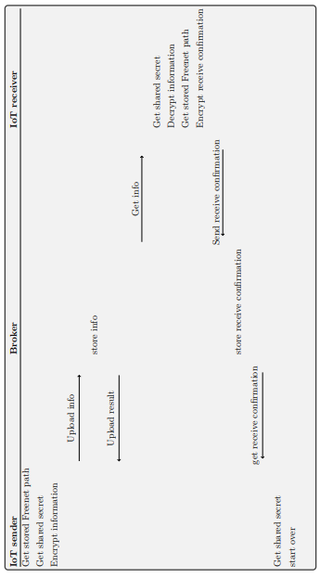
Architecture – Data transmission
Steps:
Sender get stored information
Read sensor data
Encrypt sensor data and upload
Receiver download data
Decrypt sensor data
Send receive confirmation to sender
Notes:
Let's move on to the following process. After communication has been established, data is now transferred.
The process to exchange data follows the following steps.
First, all information for the data exchange is collected on the IoT transmitter, this includes the Freenet path and the shared secret.
The information is then read from the sensors and then encrypted.
The encrypted data is then uploaded to Freenet.
The receiver then hops up this data and decrypts it.
Once the data has arrived, the receiver uploads a message to the sender on Freenet to confirm receipt.
This confirmation serves as a check whether the recipient of the data is still available.
This prevents the sender from uploading a useless amount of data to Freenet that will not be used.

Slide 10
Attacks and Prevention
Spoofing of the data
Interruption of the data flow by flooding Freenet
Phyiscal attack on IoT sender
Physical attack on Freenet Node Hardware
Notes:
Next we come to the Attacks and Prevention.
These were of essential interest for the development of the architecture.
Spoofing of the data: The information stored on the broker (freenet) can be manipulated by anyone who can connect ot the Freenet Node and also has knowlege of the Freenet URIs.
To prevent this from happening, Freenet URIs must be exchanged in encrypted form for each new connection.
Another Attack is the Interruption of the data flow by flooding the Freenet Node.
The exact behavior of Freenet and the effects due to the high load is something that needs some further investigation.
We are expecting that with a bigger scaling of the Freenet Network this attack will get insignificant.
Because of the Hardware there are also multiple Physical Attacks Possible.
Our Prototype is equipped with an SD card.
Stored on it are all the information about the connections to the receivers.
This data is stored on the SD card in encrypted form.
However, the key for this encryption is stored on the EEPROM of the IoT transmitter.
Furthermore, we have a Freenet node that is also physically located on site.

Slide 11
Conclusion
Deffined / Developed a new communication path
Anonymous and protected communication implemented
Was a very demanding work
Still a lot of room for improvement (Prototype)
Was able to put many theoretical learnings into practice
Notes:
Let us come to the conclusion
A completely new communication path was defined and created.
Communication via this path was anonymized and protected from third-party access.
The work itself was very demanding, since many aspects had to be considered, in addition various problems came both with the use of different predefined libraries and with documentation of the Arduino hardware.
Therefore there is still a lot of room for improvement.
These include especially the prototype.
Nevertheless, I enjoyed writing this Bachelor Thesis and was able to put a lot of theoretical knowledge into practice.

Slide 12
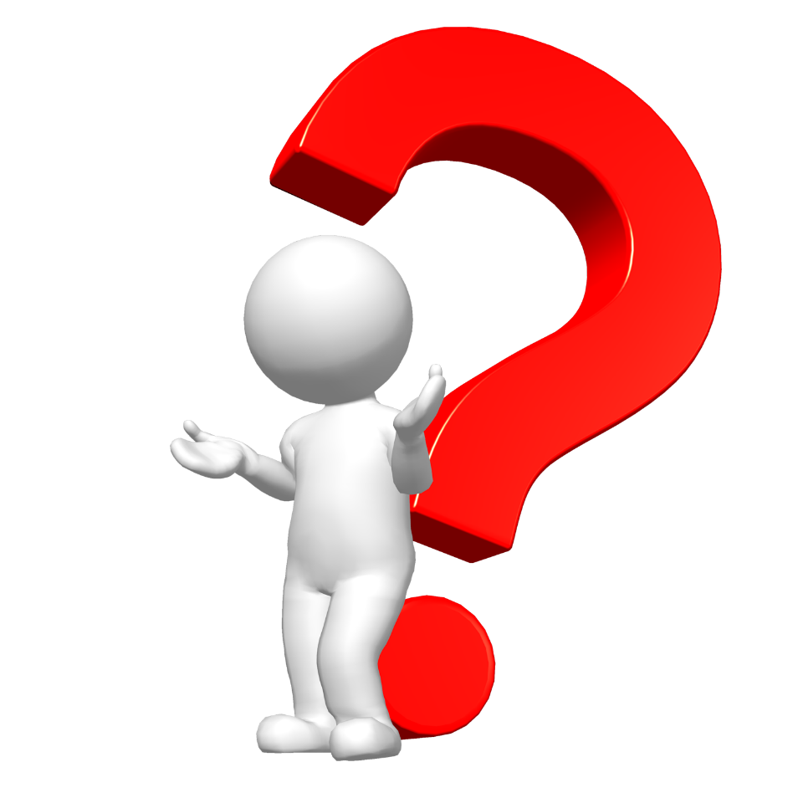
Questions
Notes:
And so we are at the end of my presentation for questions I am now available to you with pleasure

